Slide 1
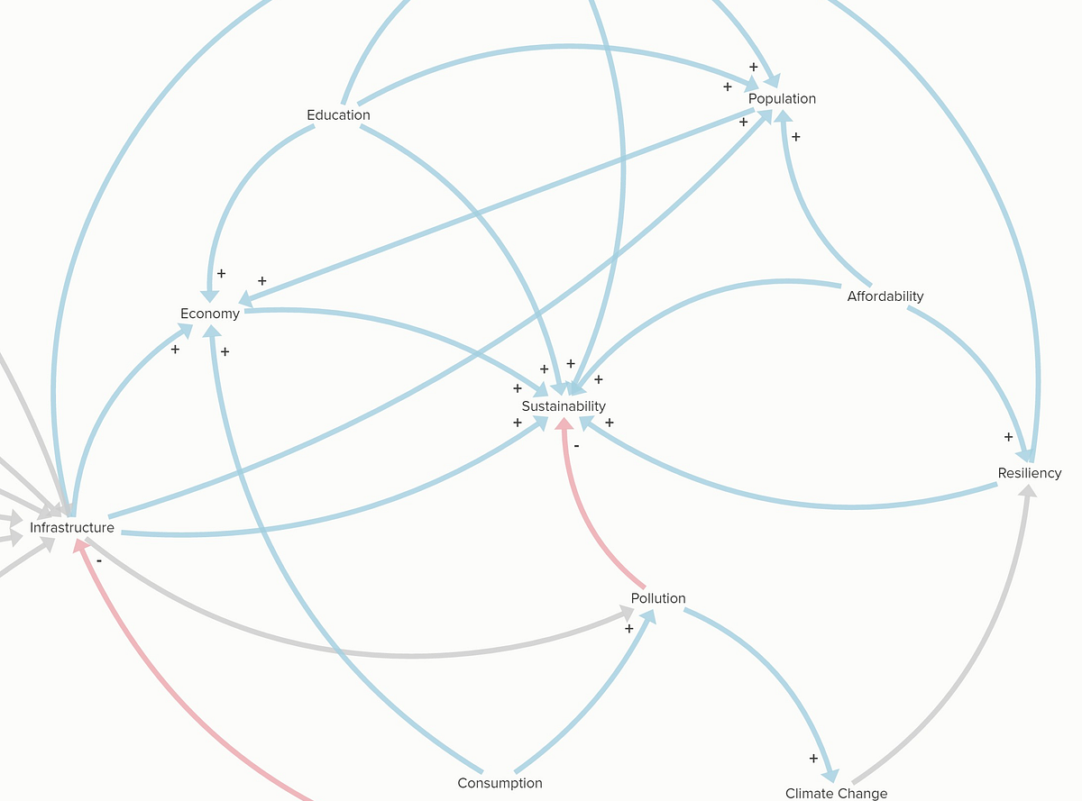
Data Science:
Causal Inference

Slide 2

Overview
Introduction
EDA
Preprocessing
Causal Estimation
Conclusion

Slide 3

Introduction
Digital gaming has seen a steep incline in the last decade coinciding with technological development. Concerns surrounding the impacts of digital gaming on health, both mental and physical, have always been present, with increasing focus on the mental impacts in recent years. As digital gaming becomes more accessible and therefore widespread, the question of whether it directly causes or amplifies mental health issues is more crucial than ever.
In this project we will use the principles of a Causal Inference workflow to investigate the possible causal relationship between digital gaming and mental health, bearing in mind that correlation does not always indicate causation.
The overall goal is to showcase an understanding of causal inference analysis, along with proficiency in the use of python libraries and machine learning models.

Slide 4
Project Scope
Section | Summary
A: Analysis Setup | Define the problem and plot a detailed DAG (Directed Acyclic Graph) using knowledge and assumptions about the data. Identify the treatment, outcome, confounders from the DAG.
B: EDA, Preprocessing | Perform EDA (exploratory data analysis). Check the data against the assumptions of causal inference. Preprocess the data to define treatment and outcome variables.
C: Balance Checking, Adjustments | Define treatment and control groups. Assess balance between treatment and control groups before and after adjusting for problematic variables.
D: ML Modelling, Causal Analysis | Fit an outcome model with robust standard errors to estimate the causal effect (ATE) using the adjusted data. Validate model results and check for robustness.

Slide 5
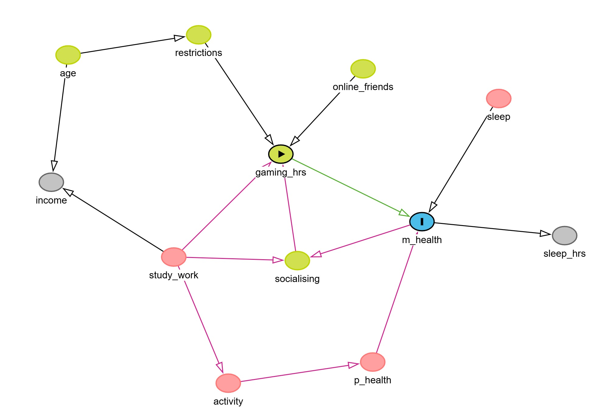
The Direction Acyclic Graph (DAG)
The first step to outlining the analysis problem was plotting the relationships between possible confounders to the main relationship ‘gaming_hrs -> m_health’..

Slide 6

EDA
Exploratory Data Analysis

Slide 7
Exploratory Data Analysis (EDA)
Since the dataset was too large for computational efficiency, a subset representative of the full dataset was extracted through random selection.
The following slides provide a look at a few of the distribution plots created for the EDA. Overall, partially due to the data used in this project being synthetic, the distributions of the subset were balanced and evenly distributed.

Slide 8
Daily Gaming Hours Distribution
Full
Subset

Slide 9
Gender Distribution
Full
Subset

Slide 10
Violent Games Ratio Distribution
Full
Subset

Slide 11
Assumptions of Causal Inference
Before and during preprocessing, we check the data subset against the assumptions of causal inference:
SUTVA: Assume each individual’s result depends only on their own treatment.
Exchangeability/Ignorability: Adjust for confounders to make fair comparisons.
No Multicollinearity: Check that confounders are not too closely related. (Using heatmaps or pair plots)
Overlap (Positivity): Ensure there are enough people in each group for all confounder values (Part of checking for balance).

Slide 12
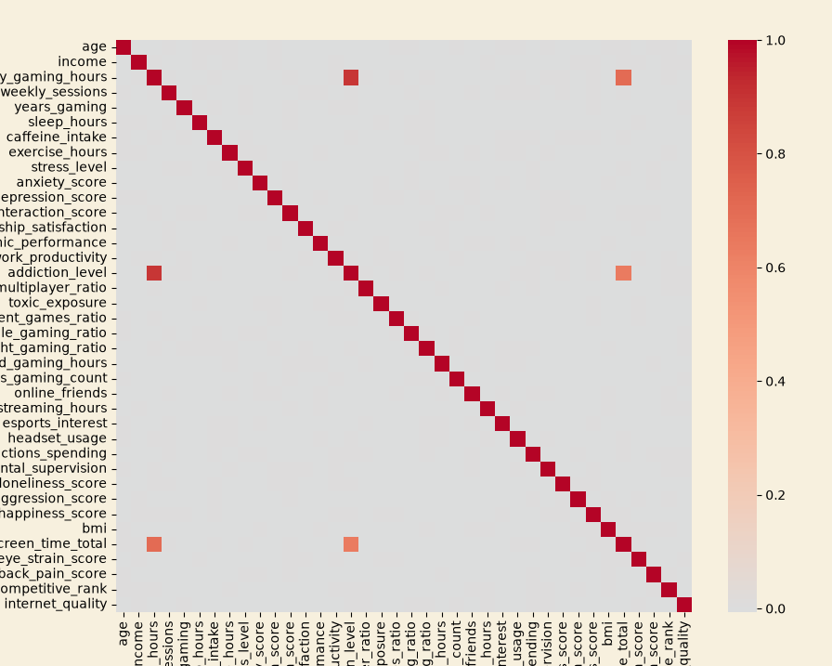
Checking Assumptions: Multicollinearity
Very few of the columns appeared to have strong correlations. The columns which did have multicollinearity were adjusted for in the preprocessing stage.

Slide 13

Preprocessing
Cleaning and preparing data

Slide 14
Preprocessing Steps
Extract
The X variable `gaming_hrs` and the Y variable `m_health` were created.
Adjust
Principal Component Analysis (PCA) was used to replace the multicollinear confounders with an adjusted covariate representing them.
Drop
Columns that were used to create other variables were dropped.
Columns which could have introduced bias were dropped.
A variable separating rows with above 15% of average gaming hours was created.
Extracted X ‘treatment’ and Y ‘outcome’ values and split treatment and control groups by gaming hours.
Adjusted for multicollinearity and imbalanced variables
Dropped uninformative or excess confounding columns

Slide 15
Product benefits
Increased productivity
Seamless integration
Enhanced user experience
Scalability for future growth
User-friendly learning

Slide 16

Market overview

Slide 17

Market comparison
Stands out in market
Innovative features
Provides unique solution
Edge over competitors
User-focused design
Prioritizes user experience

Slide 18
Competitive landscape
Strong market presence
Positioned as a market leader
Leveraging a robust infrastructure
Dedicated team of experts
Outperforming competitors
Good brand name recognition
Need:
  More agility and adaptability
  Stronger competitive edge
  Ability to adapt swiftly
  Stay ahead of the curve
  Continuously improve offerings
  Integrate user feedback

Slide 19
Traction
Product launch
  Successful introduction of our product to market
10,000 user milestone
  Substantial user base, indicating growing demand
Strategic partnership
  Expanding market presence and capabilities
Milestone | Quarter
Product launch | Q1
10,000 user milestone | Q2
Strategic partnership | Q3
Campaign launch | Q4

Slide 20
Financials
Quarter | Revenue ($) | Expenses ($) | Net profit ($)
Q1 | $200,000 | $150,000 | $50,000
Q2 | $300,000 | $200,000 | $100,000
Q3 | $400,000 | $250,000 | $150,000
Q4 | $300,000 | $200,000 | $100,000

Slide 21
Summary
With this product, Adatum Corporation is positioned for success in the dynamic market.
With a focus on innovation, user experience, and strategic growth, we anticipate reaching new heights in the coming year.
Our commitment to user satisfaction underscores every aspect of our operations.
Strong market positioning
Robust growth strategy
Innovative product development
Commitment to user satisfaction

Slide 22

Thank you
Remi Morris
remi@adatum.com
www.adatum.com

